Slide 1
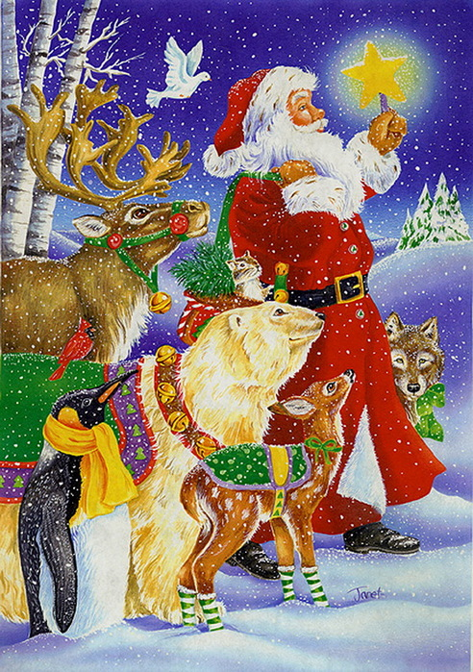
CHRISTMAS

Slide 2
The 25th of December is Christmas Day.

Slide 3
CRISTMAS is CONNECTED With BIRTH of the JESUS

Slide 4
Christmas is a family holiday.

Slide 5
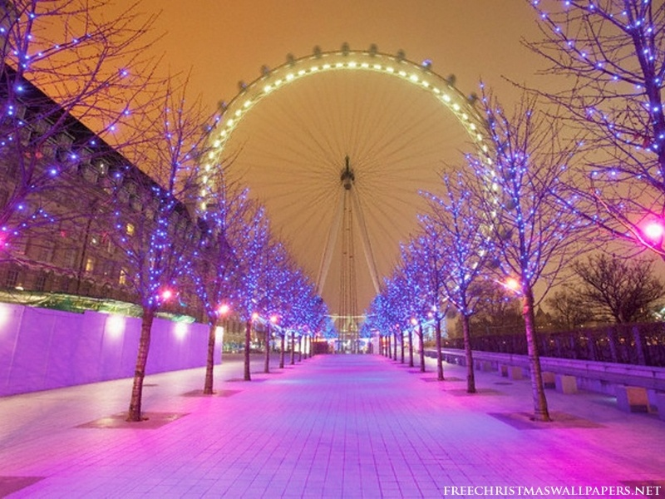
Every year there is a very big Christmas tree in the centre of London. In the evening before Christmas people like to come to Trafalgar Square.

Slide 6
People buy a Christmas tree and decorate a tree with toys, coloured balls and coloured lights.

Slide 7
Children hang stockings near the fireplace.

Slide 8
They believe that while they are sleeping, Father Christmas comes to visit them

Slide 9
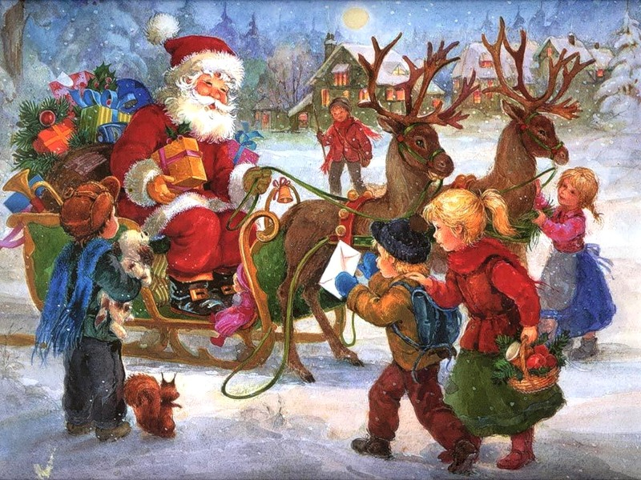
Father Christmas comes in his sleigh.

Slide 10
ON THE Christmas dinner the family eat turkey

Slide 11
This very important time for family in England

