Slide 1
What can they do?

Slide 2
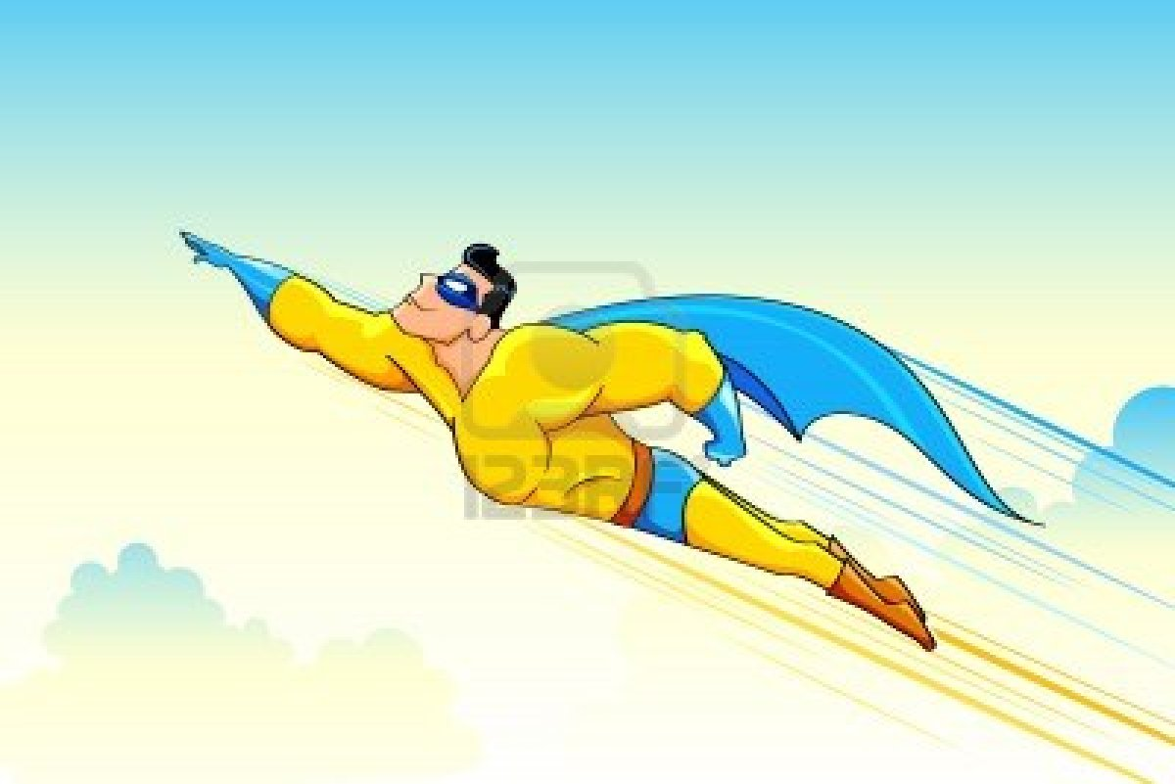
He can fly..

Slide 3
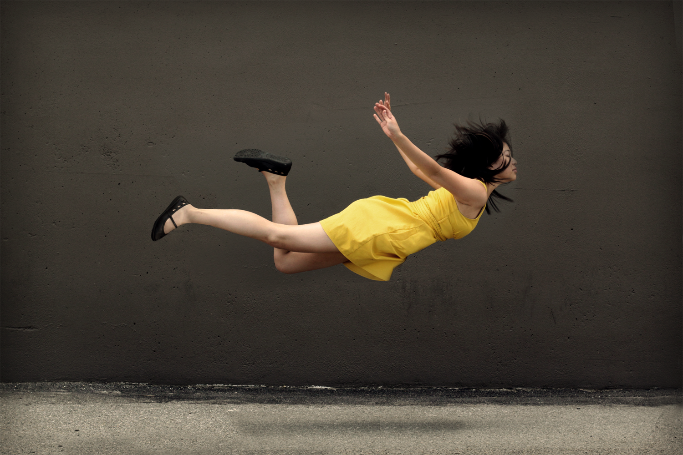
She can fly.

Slide 4
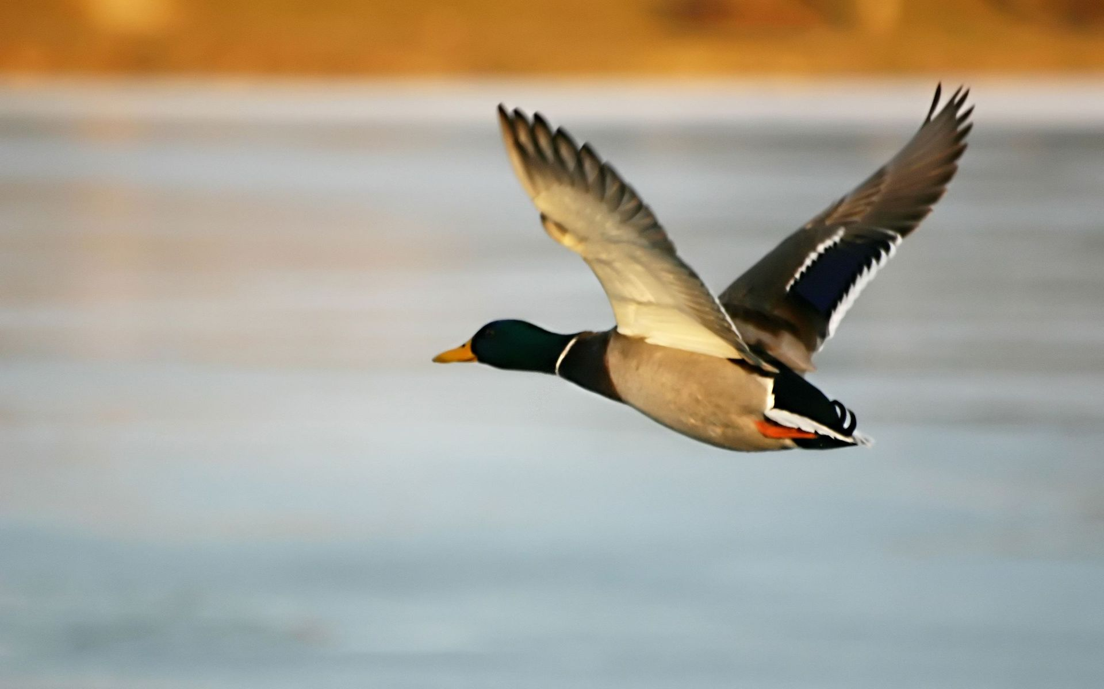
A bird can fly.

Slide 5
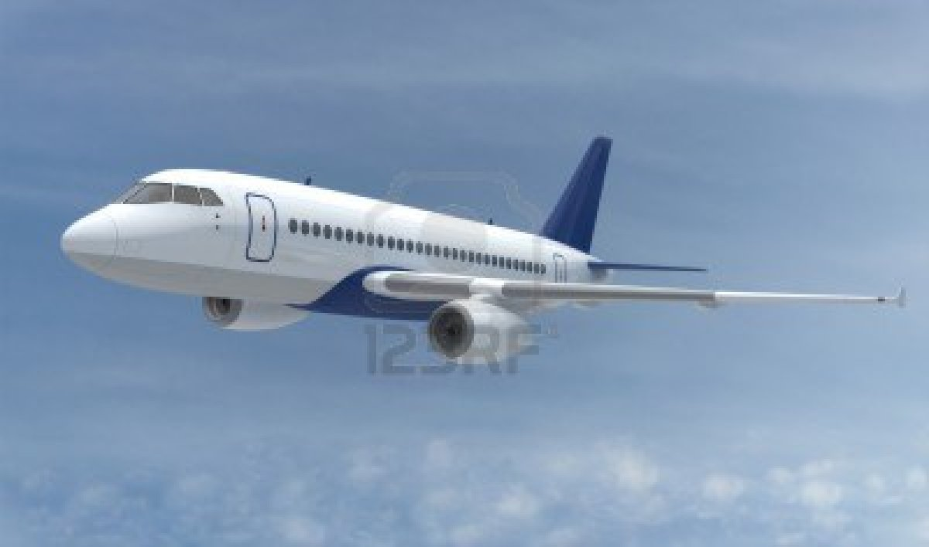
It can fly.

Slide 6
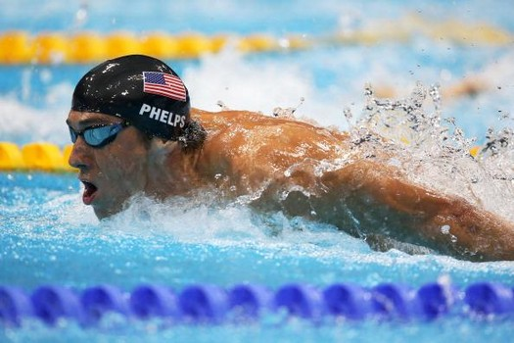
He can swim.

Slide 7
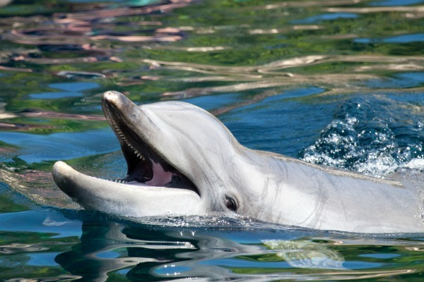
A dolphin can swim.

Slide 8
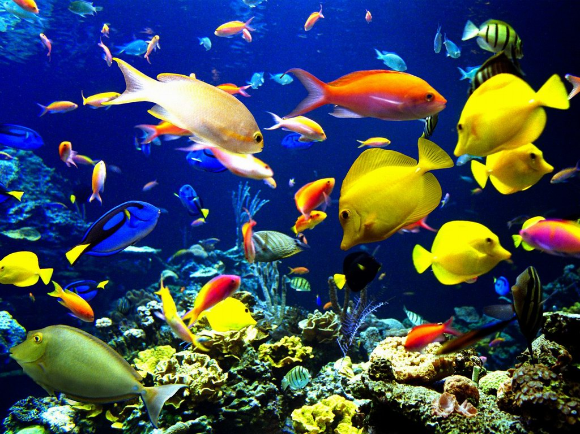
A fish can swim.

Slide 9
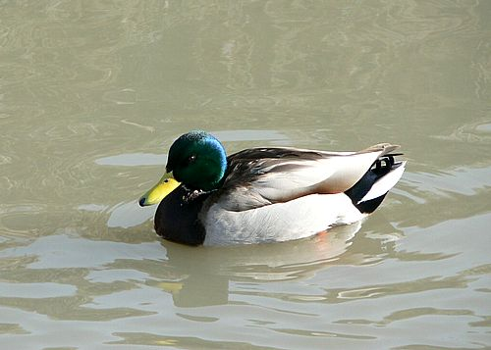
A bird can swim.

Slide 10
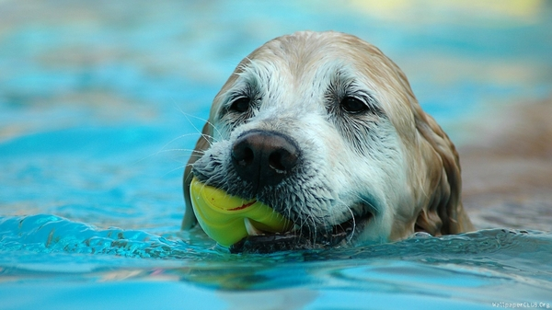
A dog can swim.

Slide 11
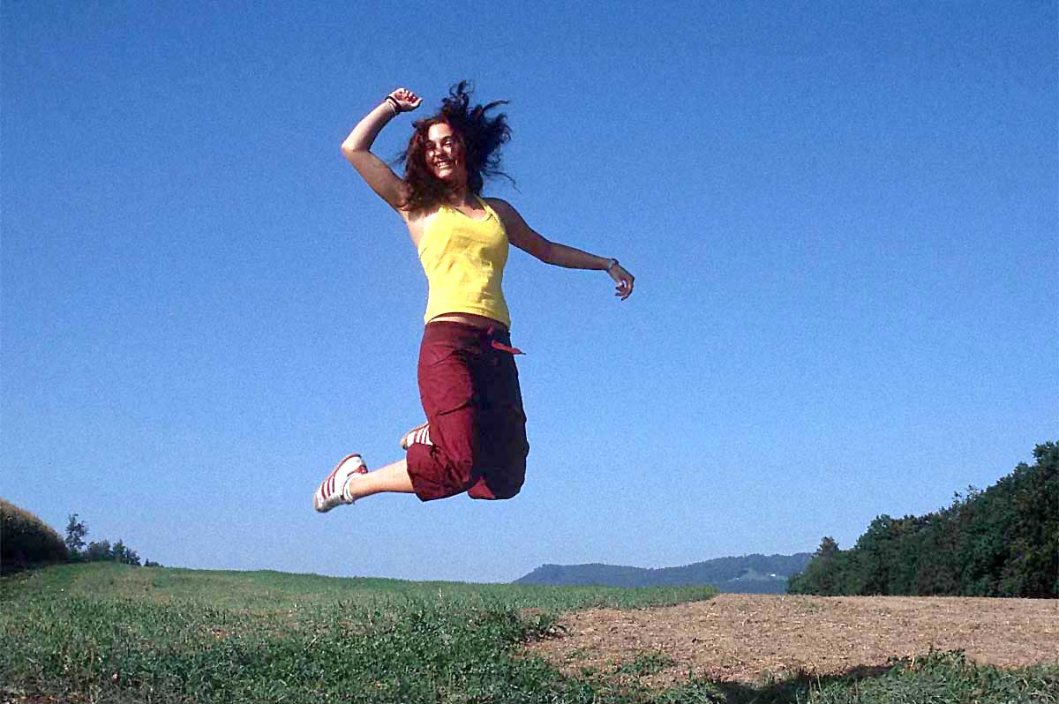
She can jump.
She can jump.

Slide 12
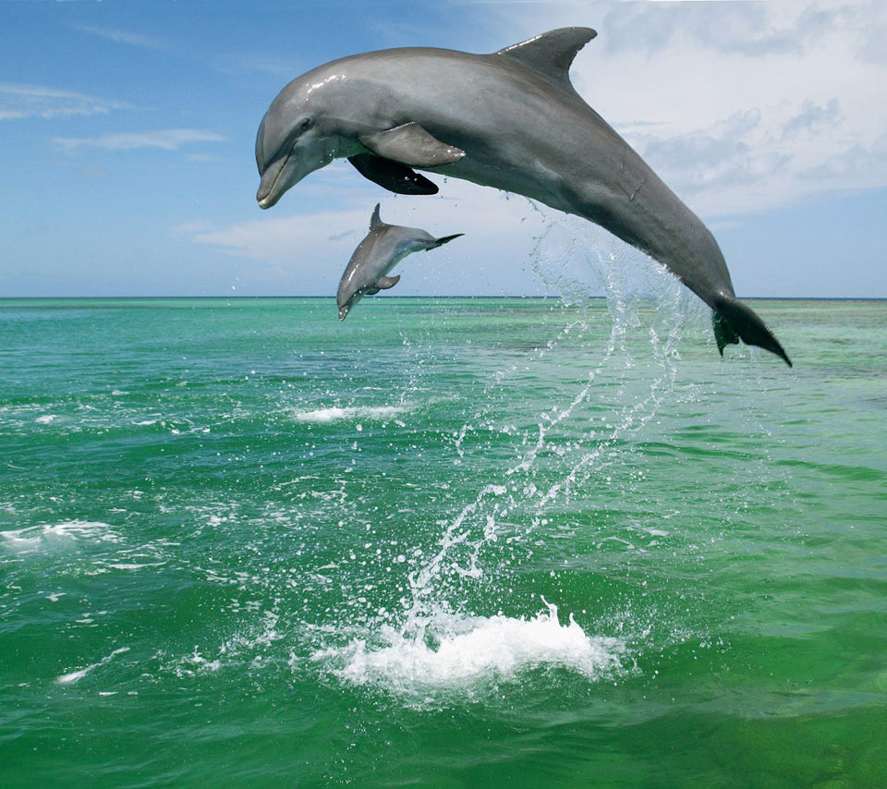
A dolphin can jump.

Slide 13
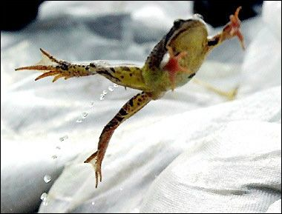
A frog can jump.

Slide 14
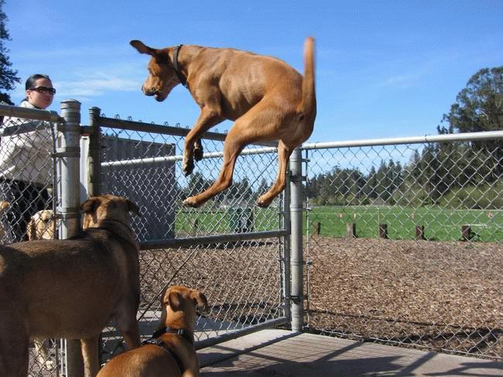
A dog can jump.

Slide 15
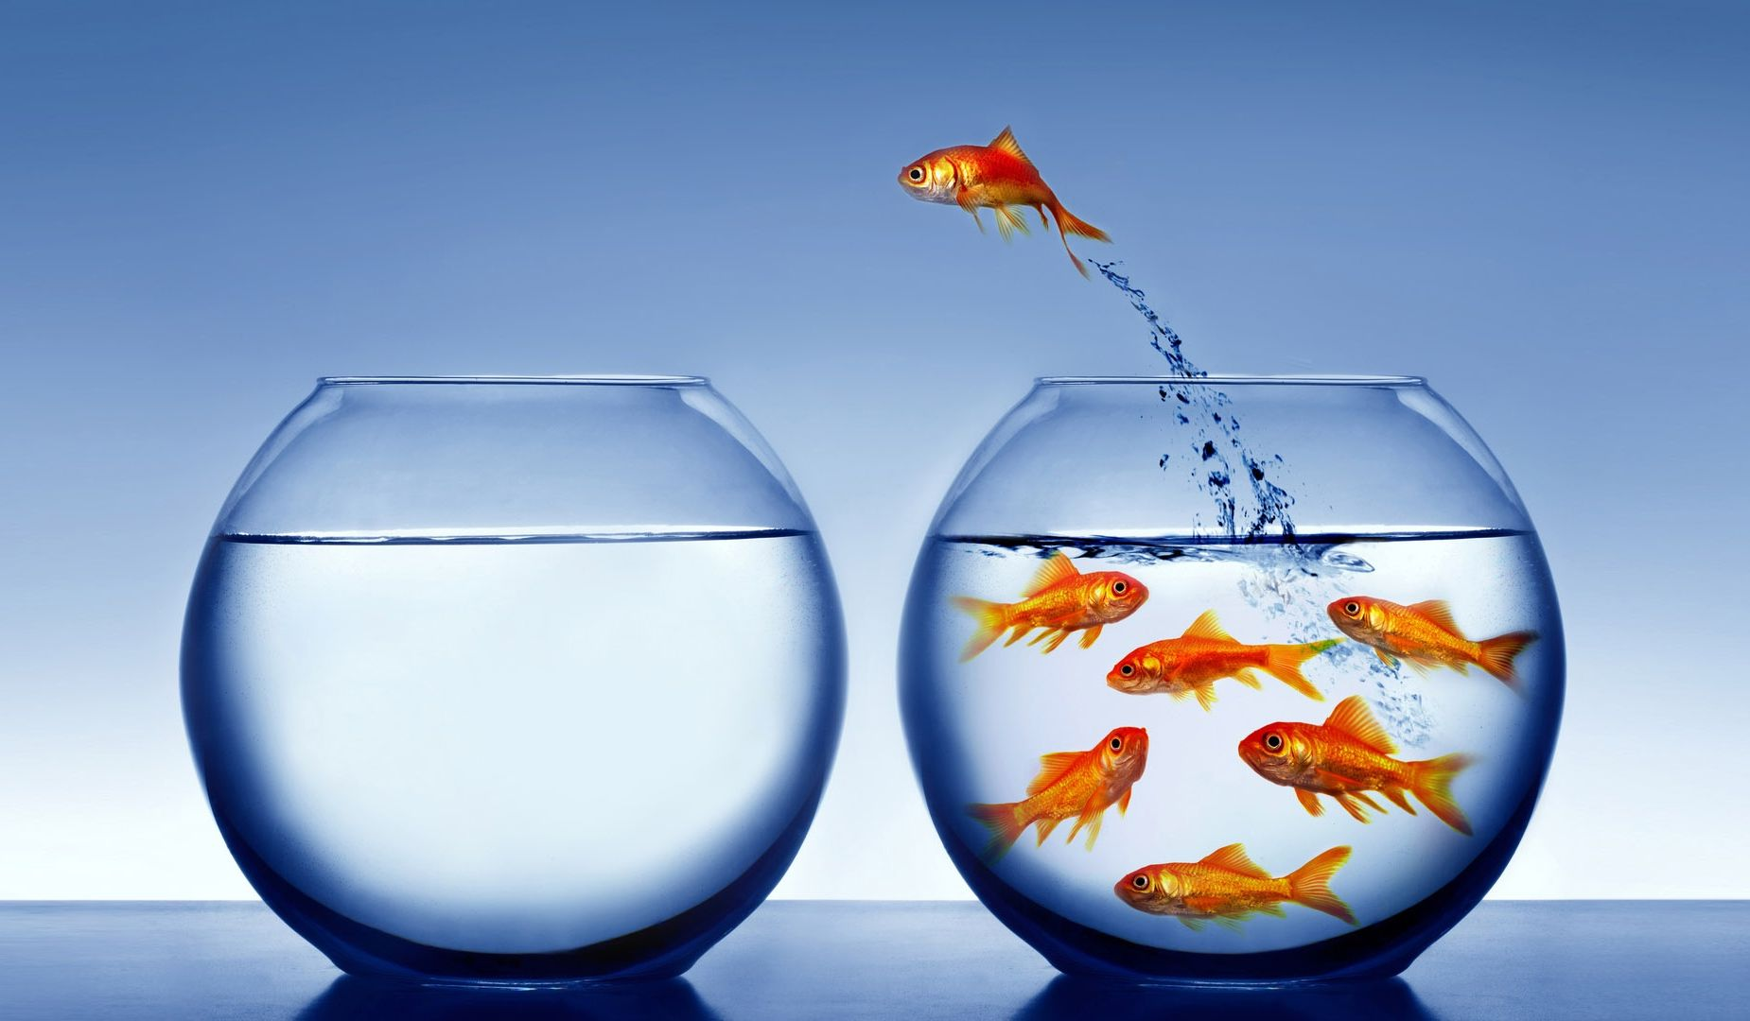
A fish can jump.

Slide 16
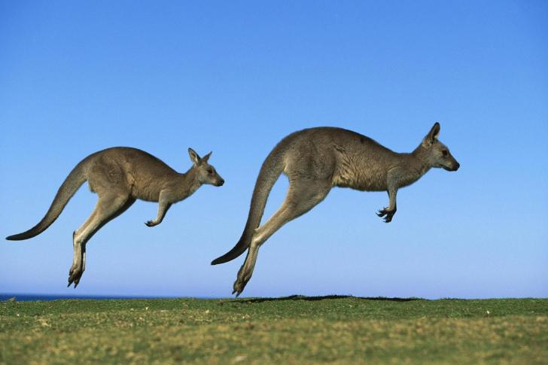
A kangaroo can jump.

Slide 17
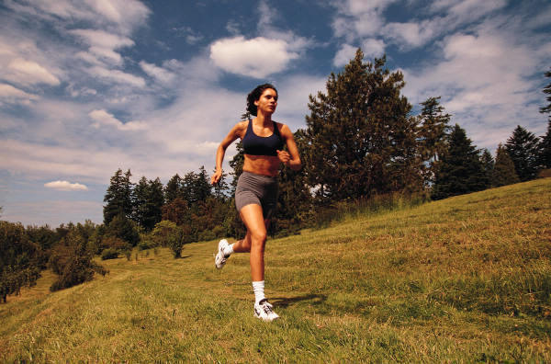
She can run.

Slide 18
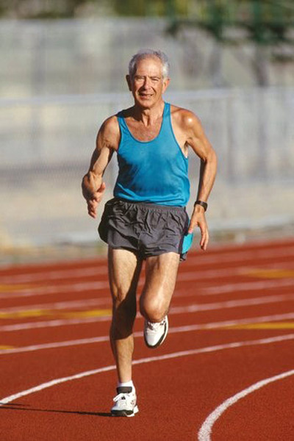
He can run.

Slide 19
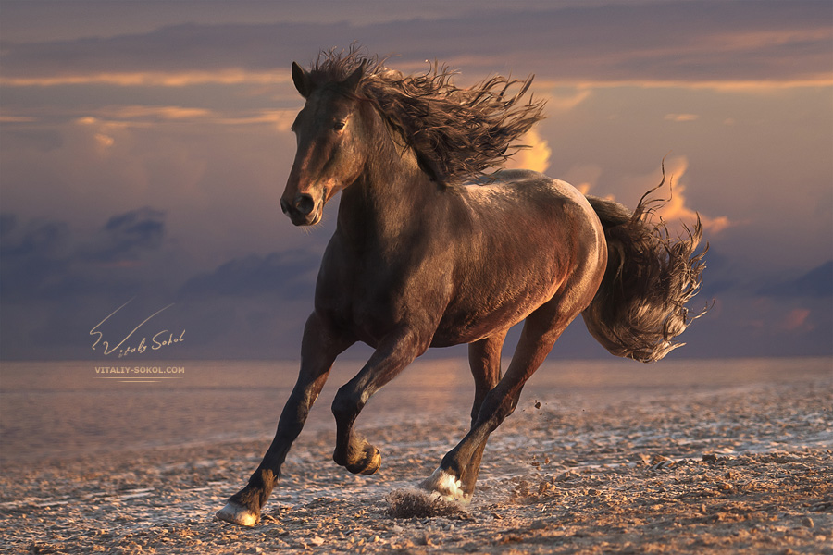
A horse can run.

Slide 20
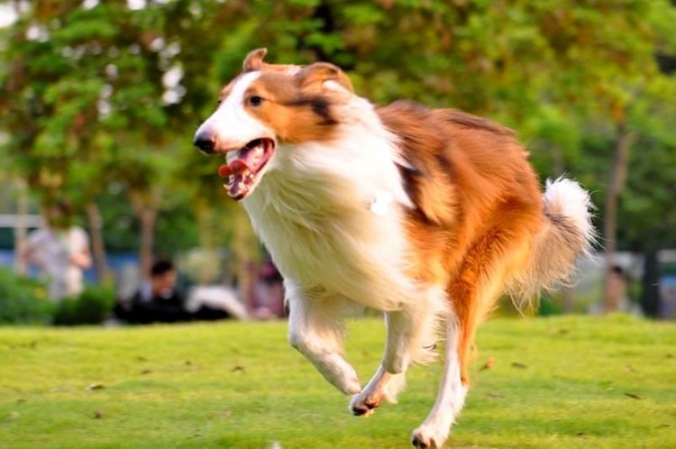
A dog can run.

Slide 21
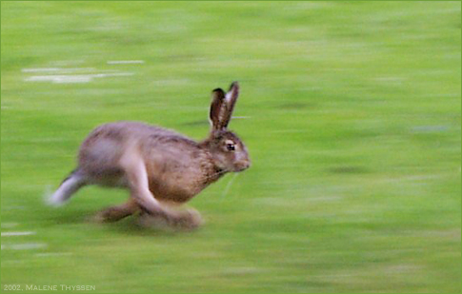
A rabbit can run.

Slide 22
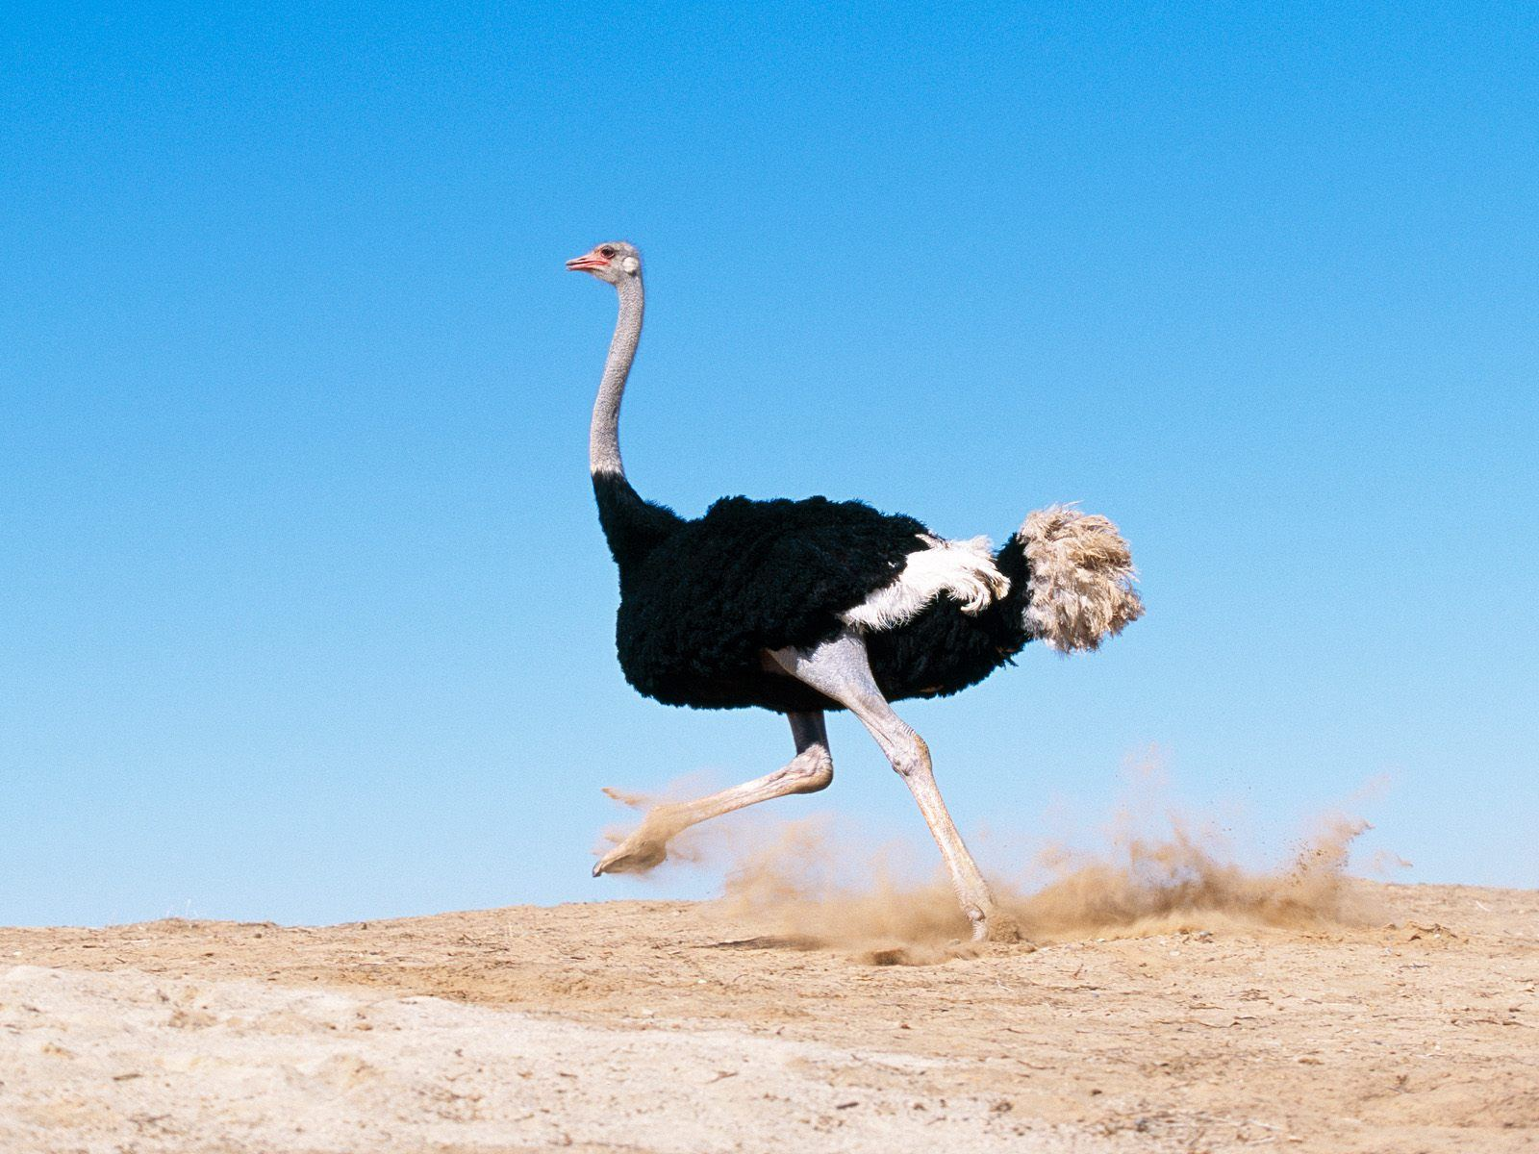
A bird can run.

Slide 23
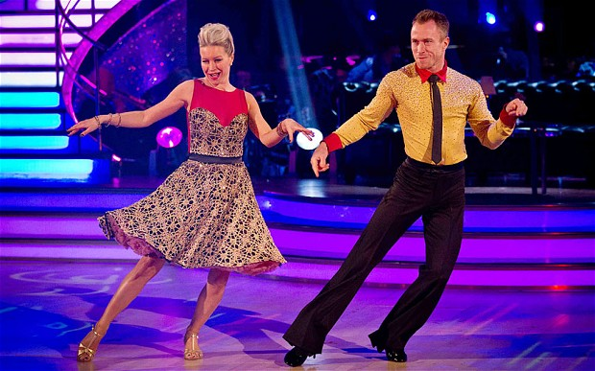
They can dance.

Slide 24
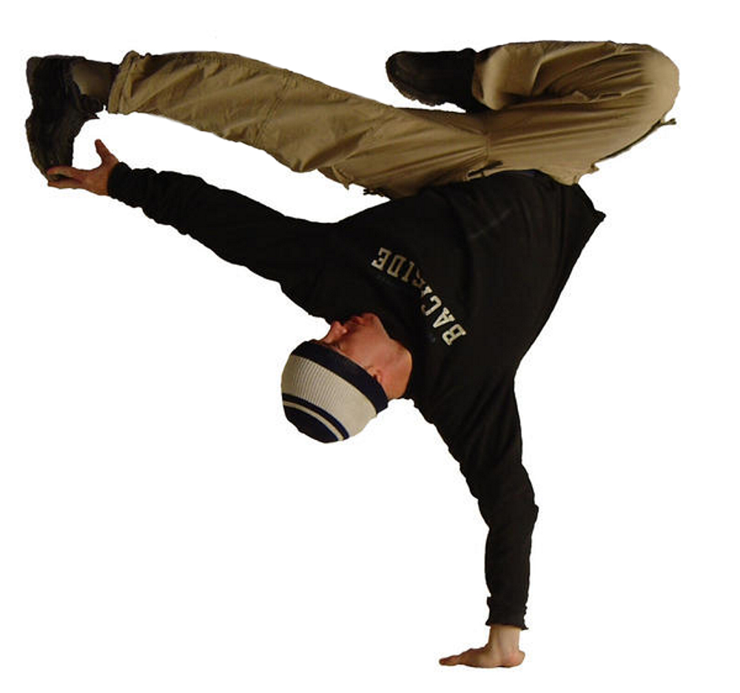
He can dance.

Slide 25
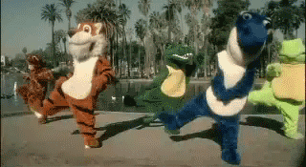
They can dance.

Slide 26
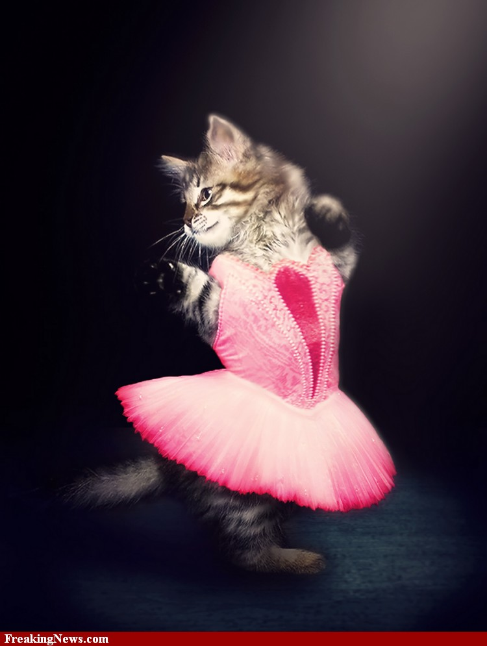
It can dance.

Slide 27
He can sing.

Slide 28
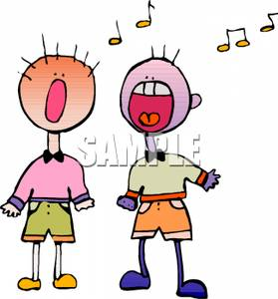
They can sing.

Slide 29
It can sing.

Slide 30
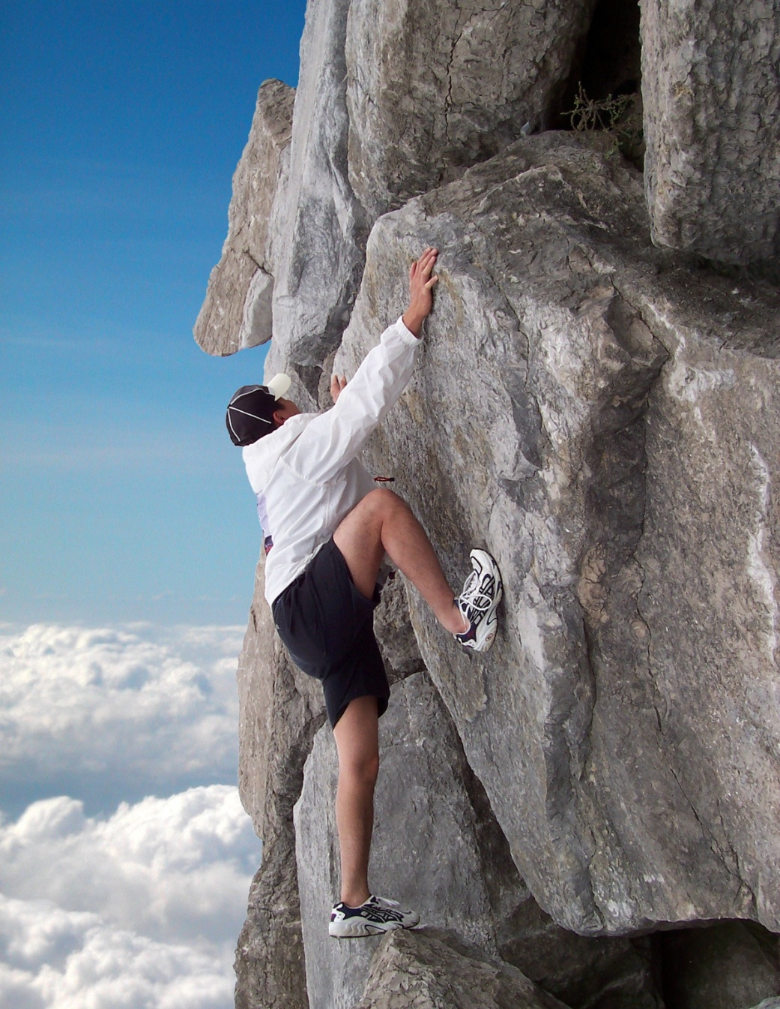
He can climb.

Slide 31
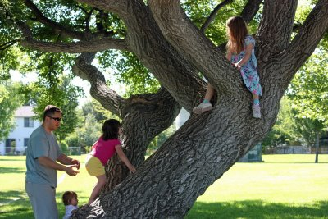
They can climb a tree.

Slide 32
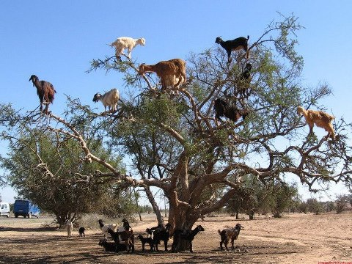
They can climb a tree too!

Slide 33
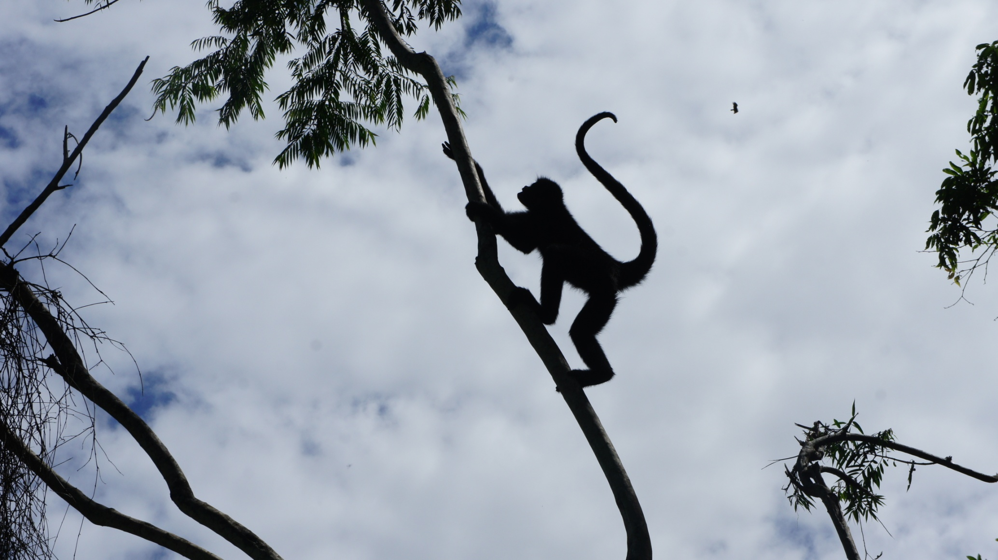
A chimp can climb.

Slide 34
Закончи предложения:
I can…
My mum can…
My dad can…
My granny can…
My grandpa can…
My brother/sister can…
My dog/cat can…

