Slide 1
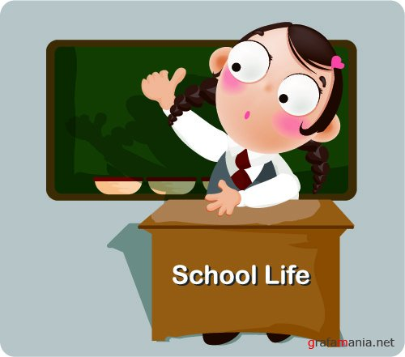

Slide 2
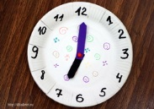
Monday He usually gets up at 7 o`clock on Monday

Slide 3
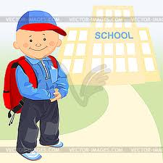
Tuesday

Slide 4
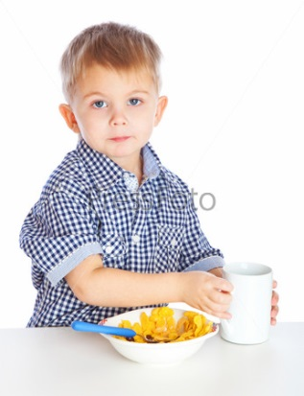
Wednesday

Slide 5
Saturday

Slide 6
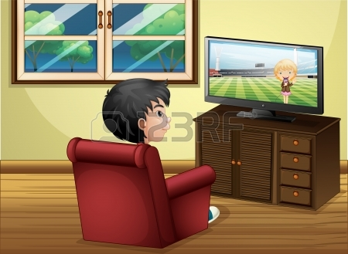
Friday

Slide 7
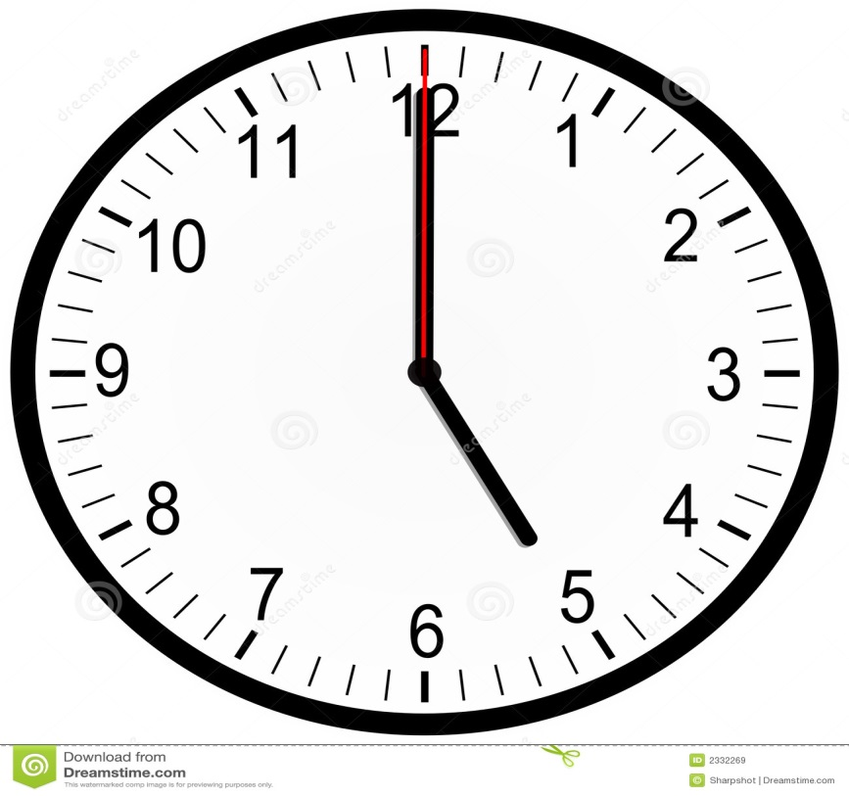
Sunday

Slide 8
Complete the sentences with: on, at, with
__ Sundays we don`t go to school.
I have dinner __ 7 o`clock
My Granny doesn`t sleep well __ night.
My birthday is __ the 2nd of June.
I go to school __ the morning.
On
at
at
on
in

